Slide 1
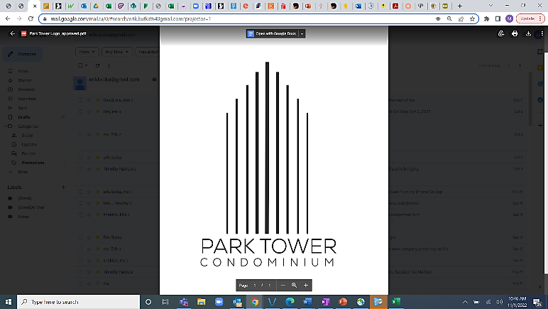
Special meeting of the unit owners
DISCUSSION of PROPOSED BUDGET FOR 2025-2026
MONDAY, JANUARY 13, 2025

Slide 2
electricity
Park Tower electricity budget increased by 22.5%
Three reasons
Capacity auction resulted in 833% increase as determined by legislation to keep up with generator retirements, increased electricity demand, and implementing Federal Energy Regulatory Commission reforms
Utility charges increased by 13% primarily due to ComEd’s carbon-free adjustment
Cost of electricity continues to trend upward

Slide 3
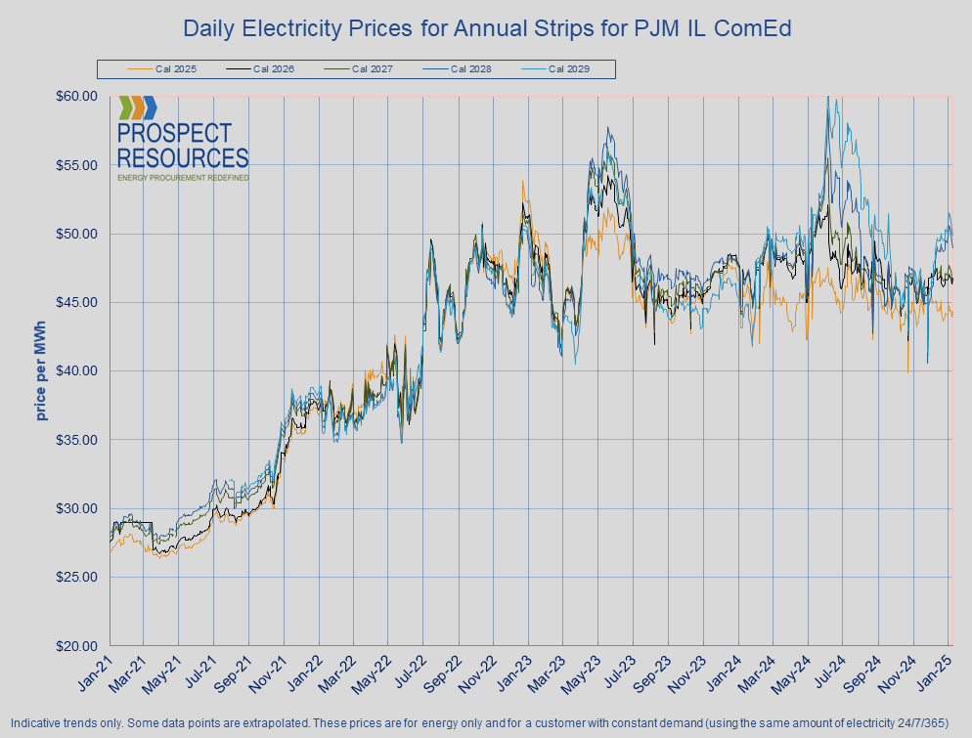
Electricity forward curves 2021-2025
Source: https://www.prospectresources.com/energy-market-trends/

Slide 4
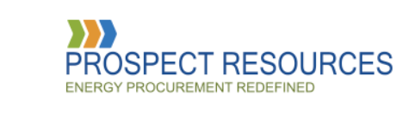
Presentation by prospect resources

Slide 5
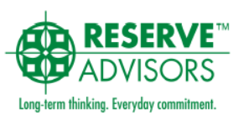
Following our professionals’ advice
Best practice states a reserve study should be done at least every five years.
The last full reserve study was done in 2024 to reflect the current economy and inflation, and to inform future assessment changes needed.

Slide 6
Our world continues in uncertainty
Insurance rates continue to go up due to natural disasters
Salaries for union staff (Local 1 and 727) continue to go up
Continued higher costs for metals, electronics, supplies, and materials
Loss of rent on the market space, unit 14c (presently vacant and listed with a commercial broker)

Slide 7
You can make a difference
Be conservative in your water use
Sign up for electronic delivery of notices versus US mailings

Slide 8
2025-2026 proposed BUDGET
Proposed 3.8% Increase in Assessments
Type | Average Increase per month
Studio | $20.30
One Bedroom | $28.31
Two Bedroom | $45.64

Slide 9
2025-2026 proposed BUDGET
Proposed Changes:
Those that use the garage should bear most of the burden
Guest Parking | Increase $1 (from $10 to $11) – Book of 5 coupons would increase from $50 to $55
Valet Parking | Increase $5 (from $160 to $165)
Self-Parking | Increase $5 (from $160 to $165)
Premium Parking | Increase $5 (from $175 to $180)
Tandem Parking | Increase $2.50 per vehicle (or $5 for the one spot, from $260 to $265)
Commercial Day Parking | Increase $7 (from $208 to $215)
Hourly Parking | Increase $1 per bracket (i.e., 1 hr = from $14 to $15, 1-3 hrs = from $16 to $17, etc.)

Slide 10
2025-2026 proposed BUDGET
Health Club Membership – Propose increase of 5%
 | Park Tower | 5445 and 5455 N. Sheridan Road
Single 1-month | From $43 to $45 | From $53 to $55
Single 6-month | From $226 to $237 | From $284 to $298
Single 1-year | From $318 to $334 | From $399 to $419
Double 1-month | From $64 to $67 | From $80 to $82
Double 6-month | From $353 to $371 | From $441 to $463
Double 1-year | From $573 to $602 | From $717 to $753
Family 1-month | From $90 to $94 | From $113 to $116
Family 6-month | From $509 to $534 | From $636 to $668
Family 1-year | From $798 to $838 | From $998 to $1,048

Slide 11
2025-2026 proposed BUDGET
Bike Room | Increase $15 (from $60 to $75 for lower rack)
 | Increase $2 (from $48 to $50 for upper rack and wall-hanging)
 | Increase $5 (from $30 to $35) for winter rate
Astound (formerly RCN) Bulk Cable/Internet | Increase $3.76 (from $59.15 to $62.91)
Laundry Room – NO change

Slide 12
2025-2026 proposed BUDGET
Major Projects over $50,000:
Building Automation System HVAC | $300,000
Riser Projects | $678,000
Exterior Fence with Park | $50,000
Water Valves (phase 2 of 3) | $60,000
Condenser Pump 4 | $80,000

Slide 13
Down the road…
2028-2029 – Almost $1 Million for HVAC risers and continuing amount each following year
2030-2031 - $5.2 Million for curtain wall sealants
2031-2032 - $2.5 Million for passenger elevator controls and equipment
2032-2033 - $1.4 Million for service elevator controls and equipment
2033-2034 - $3.4 Million for main boiler replacement

Slide 14
BUDGET INCREASE HISTORY
80/81 – 16% | 91/92 – 2% | 02/03 – 4% | 13/14 – 3.5% | 24/25 – 4%
81/82 – 14.1% | 92/93 – 4.75% | 03/04 – 1% | 14/15 – 3.5% | 25/26 – 3.8% ?
82/83 – 14.6% | 93/94 – 5% | 04/05 – 2% | 15/16 – 3.5% | 26/27 – 3.95% ?
83/84 – 8.5% | 94/95 – 5% | 05/06 – 3.75% | 16/17 – 3.5% | 27/28 – 3.95% ?
84/85 – 0% | 95/96 – 5% | 06/07 – 6.26% | 17/18 – 3.5% | 28/29 – 4.1% ?
85/86 – 3.8% | 96/97 – 5% | 07/08 – 8% | 18/19 – 3.5% | 29/30 – 4% ?
86/87 – 2% | 97/98 – 4% | 08/09 – 5% | 19/20 – 3% | Sneak peek
87/88 – 2.5% | 98/99 – 2.5% | 09/10 – 5.6% | 20/21 – 3.5%
88/89 – 0% | 99/00 – 3% | 10/11 – 3.75% | 21/22 – 3.4%
89/90 – 0% | 00/01 – 2% | 11/12 – 1.3% | 22/23 – 3.9%
90/91 – 8% | 01/02 – 3.5% | 12/13 – 3.5% | 23/24 – 4.5%
Average (all years) | 4.40%
Average (last ten years) | 3.66%

Slide 15
What our assessments cover
Bicycle Room (subsidy)
Cable, including Showtime
Doorman 24/7
Dry cleaning drop off / pick up (PressBox by Tide Spin)
Guest parking (subsidy)
Habitat onsite management team
Health Club (subsidy)
Heating and air conditioning
High speed internet and broadband
Hikers (car parkers) 24/7
Insurance (common property and liability)
Landscaping and snow removal
Laundry room
Lobby furnishings and décor
Lock out service
Maintenance 24/7
Otis elevator maintenance
Package room
Real estate tax appeals (periodic)
Reserve fund for scheduled maintenance / repairs / emergencies
Rooftop deck and garden
Security equipment and personnel
Social Committee functions
Utilities in common areas
Waste removal and recycling
Water and sewer
Window washing (exterior)
Work orders
(original list from TowerTalk contributors / unit owners Dan Johnston and Catherine Kestler)

Slide 16
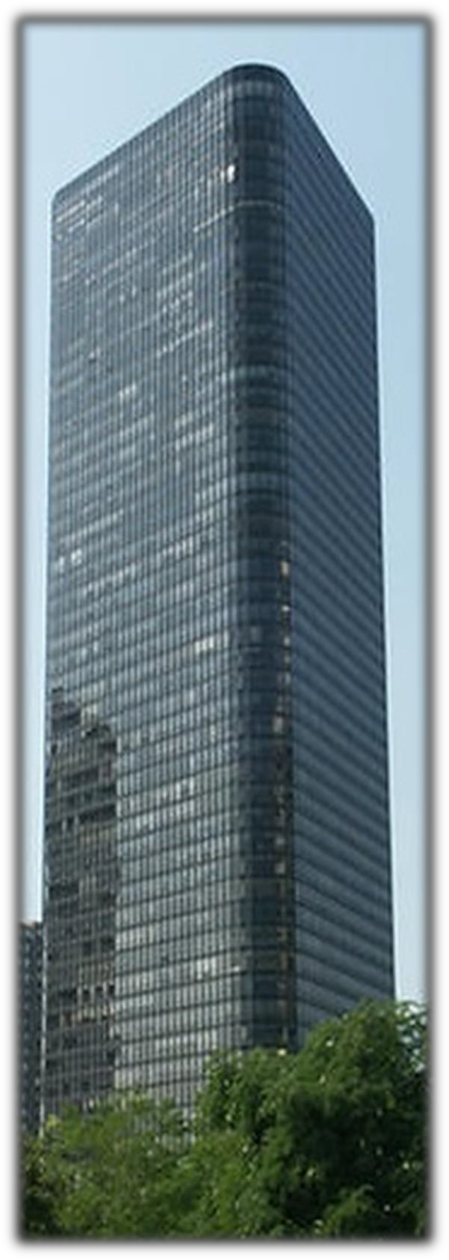
Never Had a Special Assessment!
Let’s Keep It That Way

